Slide 1


trusted engineering partner for digital transformation
Query Classifier
Grid Dynamics
www.griddynamics.com
MARCH 2024

Slide 2

The Need For Sturdy Classification of prompts
For Large Language Models, One of the most important task is to classify the prompts to avail the following advantages:
Model Specialisation
Improved Performance
Enhanced Understanding
Contextual Understanding
Where can our classification be used?
Question Answering Systems:
Content Recommendation Systems
Search Engines
Document Management Systems:

Slide 3
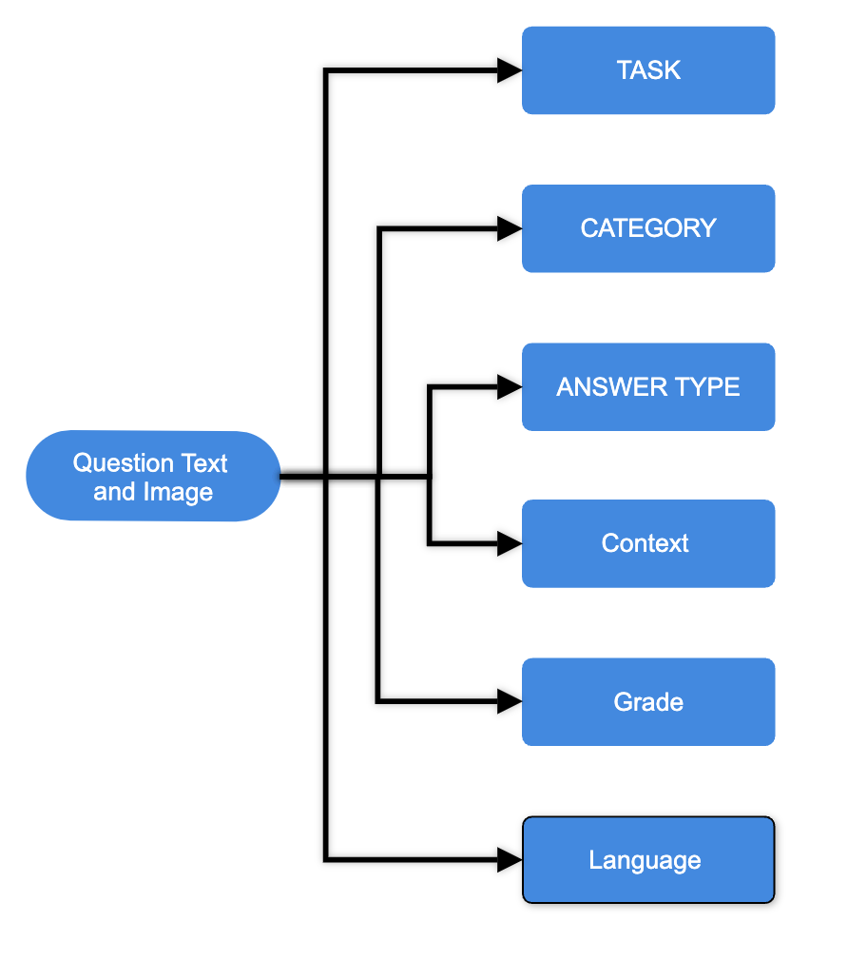
About Our Dataset
We are using AI4MATH’s Math Vista Dataset which is publicly available on hugging face.
It is used as bench marking LLM models likes GPT4, IntelVL-chatV1.2 plus, Bard Gemini etc.
Dataset Specifics:
Dataset has two categories : “Test” and “Test mini”
Each element provides us with Question text, Image aiding the question and various categories the test case belongs to.
Few Categories are : Answer type, Question Language, Category, Task, Context, Grade, Skills and a few more.
Each row always has Question and Image in all the columns and there are no voids in the dataset. Almost all classes too have values and very little nans.

Slide 4
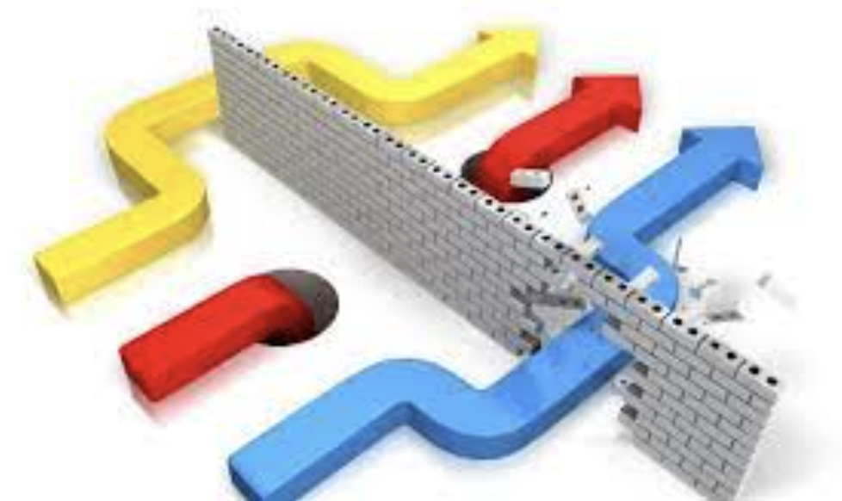
Different Approaches Possible:
There are 3 different approaches possible when giving data:
When Only the Question is given and no image.
When Only Image Showing The Question is given
When Both Question and image is given
Ideally, The third case should allow us to get the best classification results. Our results will see if that is the case and can this be said for all the classes?

Slide 5
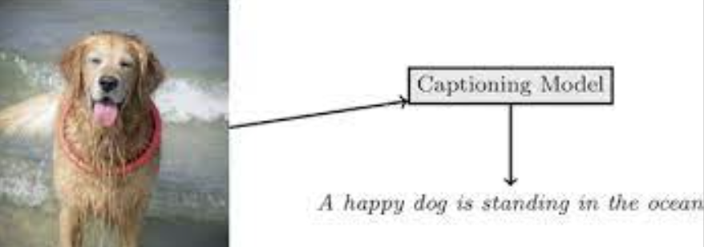
The Task Of Image Captioning
We are going to deploy transfer learning for captioning out images. There are many models for image captioning, VIT-GPT2, BLIP image captioning, Llava are the 3 most popular models.
In VIT GPT2, encode used is Visual Transformer, decoder used is GPT2. After testing, it was found out by me that this model successfully caption day to day images but struggles against math problems. It does not work good for graphs, reasoning, data comparison. Since our dataset mostly deals with mathematical and analytical data.
Llava model, which is arguably the best image captioning model, also used in GPT4, is another great option. But the llava only runs on Nvidia's CUDA GPU, and is not compatible with the mps_device which is macbooks integrated GPU.
BLIP image captioning has base and large model. The large model issuccessful in captioning accurately the images. We use BLIP CAPTIONING in our model.

Slide 6
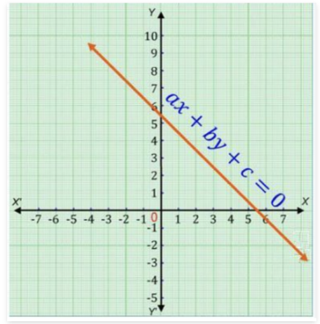
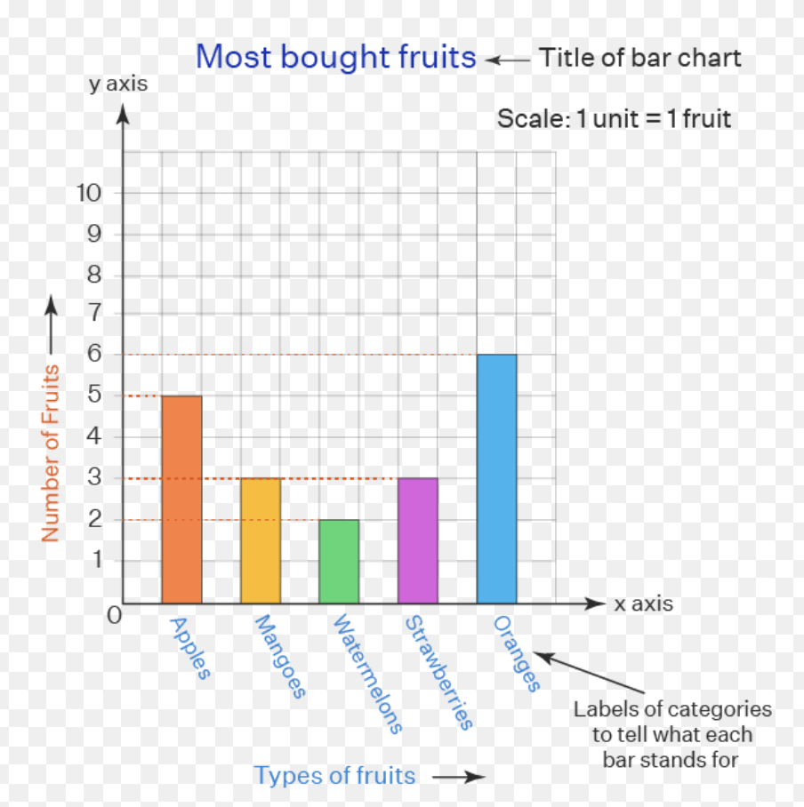
Comparing Outputs of VIT GPT2 and BLIP Large
VIT-GPT2 Captions
a piece of paper with a needle on it
a series of photos showing a variety of
colorful objects
BLIP LARGE Captions
a graph is drawn on a coordinate line
a bar chart showing different types of the fruit

Slide 7
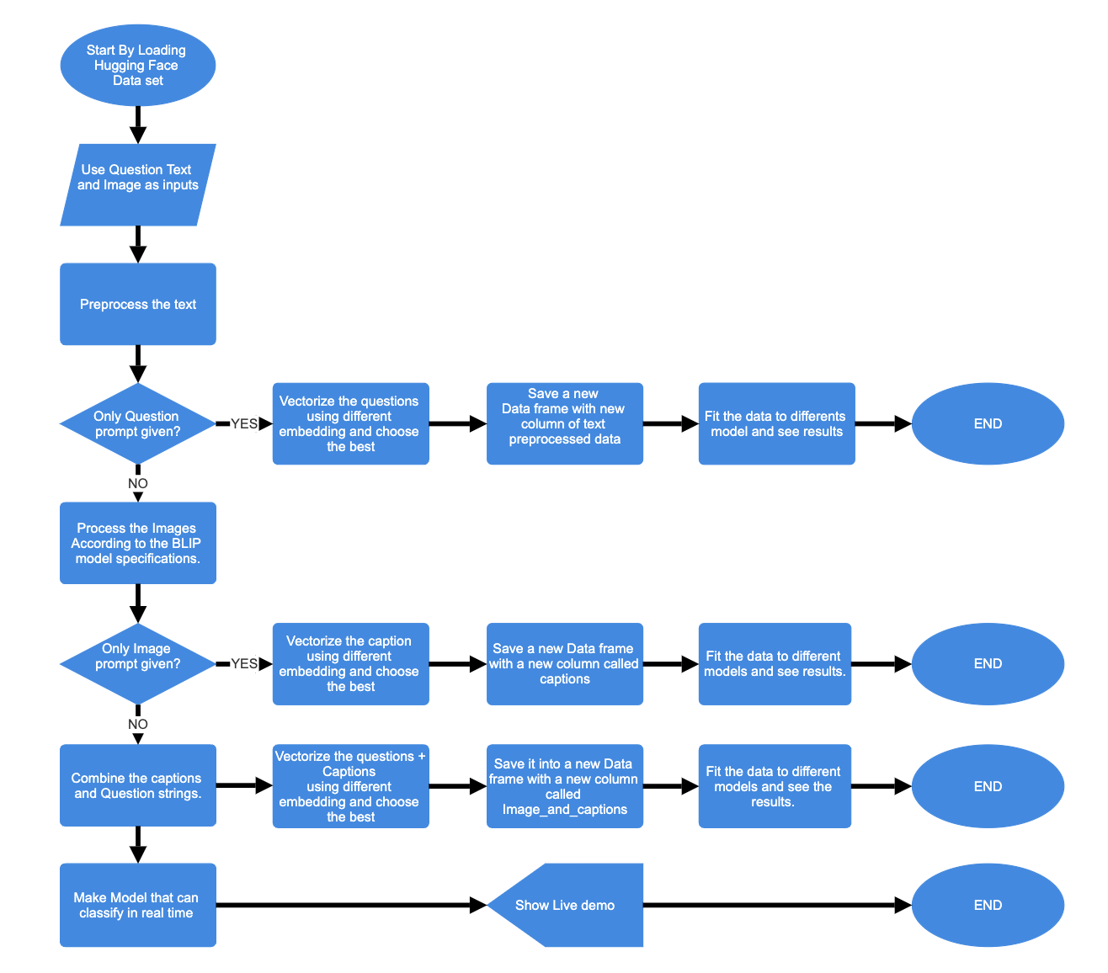
Workflow for the Project

Slide 8
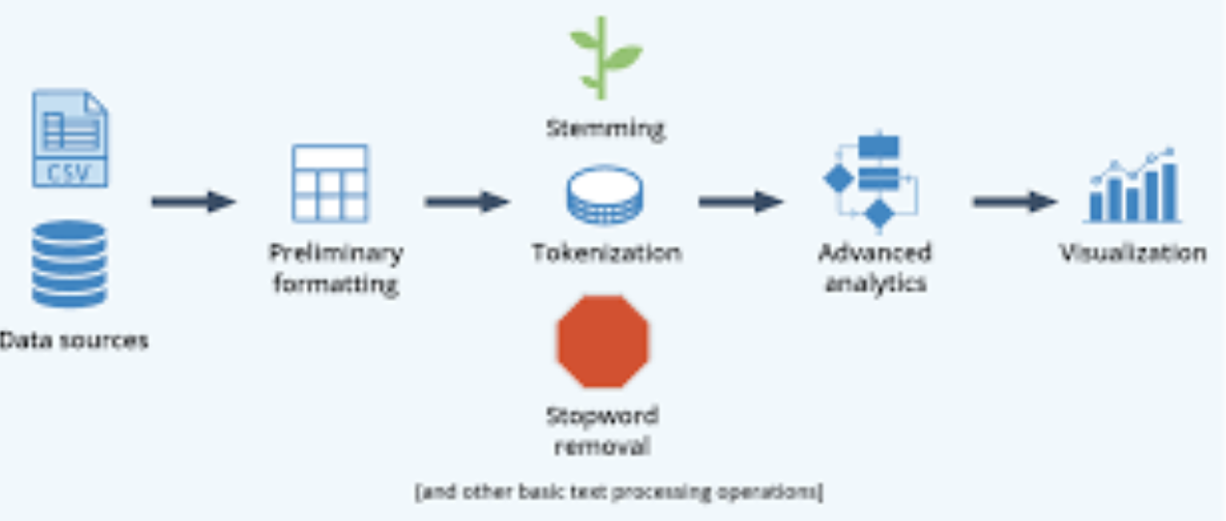
Processing text
One of the main task is processing the text given in question to make it suitable for classification.
Convert text to lower case. [ India -> india ]
Remove non alphanumeric characters. [Example %,$,#,@ etc ]
Tokenize the text
Remove stop words like [in,the,A, He etc]
Using lemmatizer to get the base of word. [Example cat and not cats]
Finally we do embeddings

Slide 9
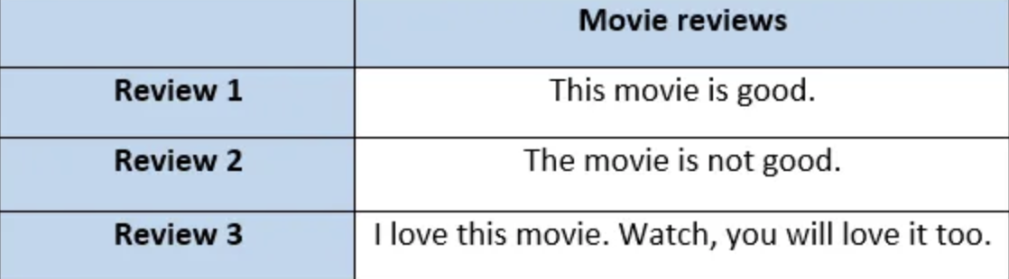
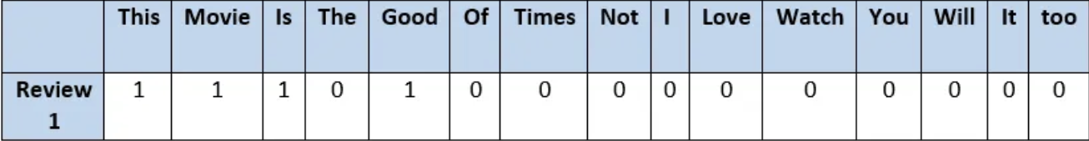
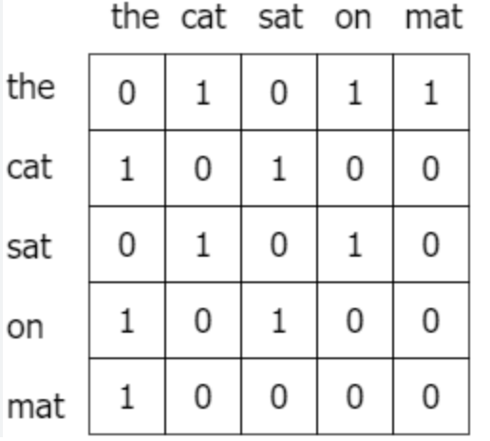
Text Vectorisation Methods
BAG OF WORDS :
GloVe Embeddings :
The cat sat on the mat.

Slide 10
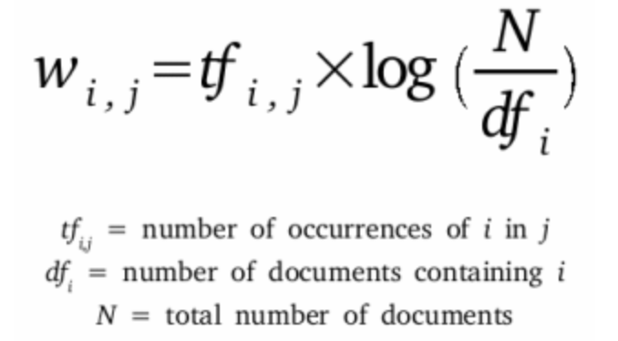
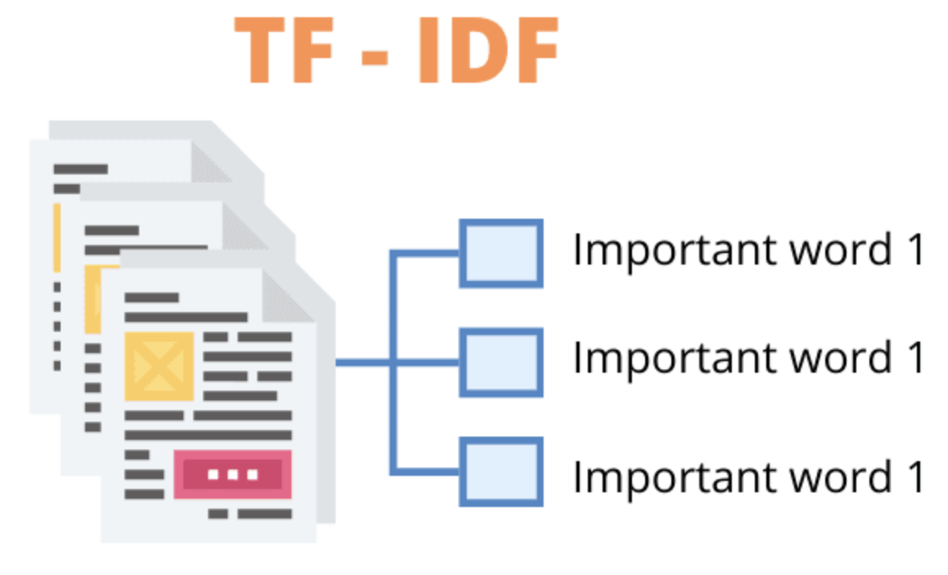
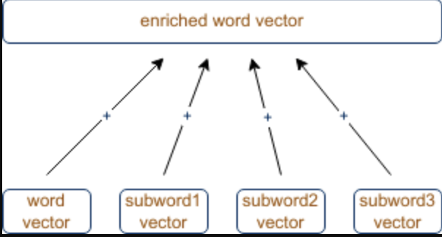
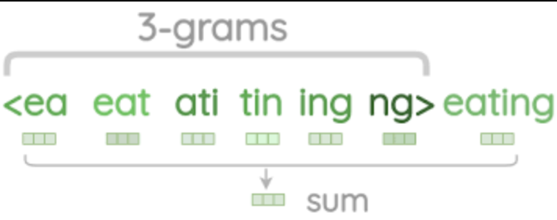
Text Vectorisation Methods
TF-IDF :
FAST TEXT :

Slide 11

Processing Images
Now we will process the images to pass through BLIP model. For this we will use transformers.
Convert image to RGB format.
Convert to torch tensor so that it can be pushed to GPU.
We Use the processor directly which is provided for the model.
Set return_tensors = ‘pt’. This will return PyTorch Tensors.
Then Generated the corresponding captions.

Slide 12
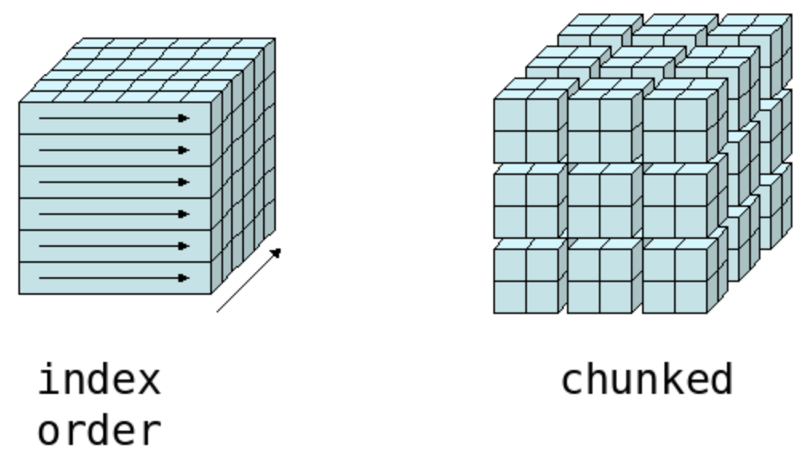
Generating Captions In Chunks

Slide 13
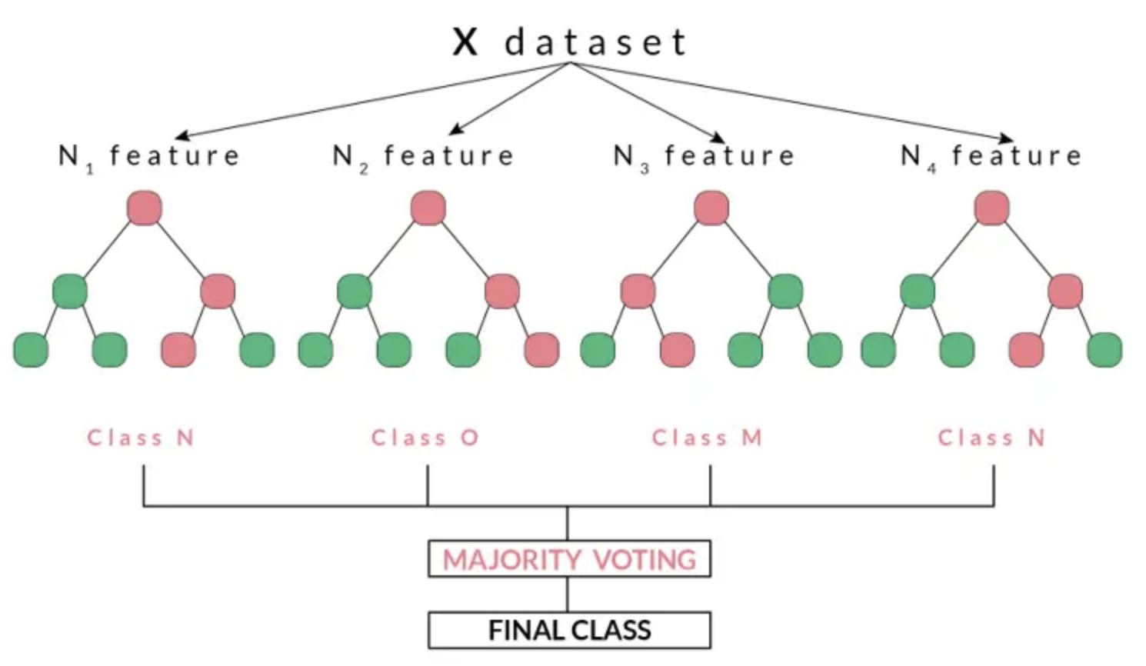
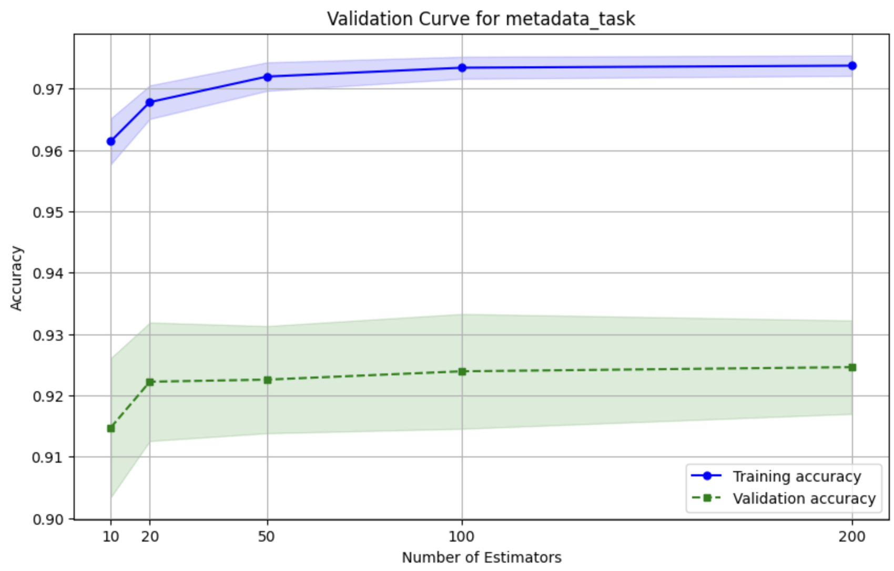
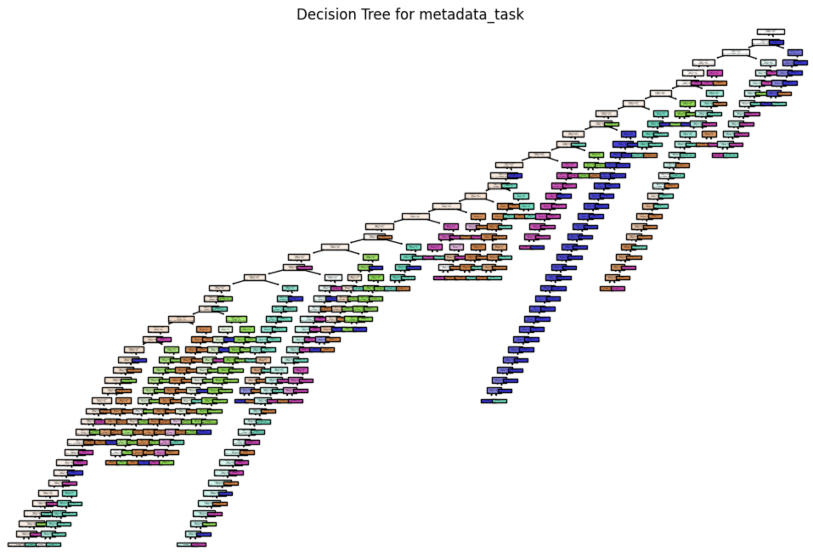
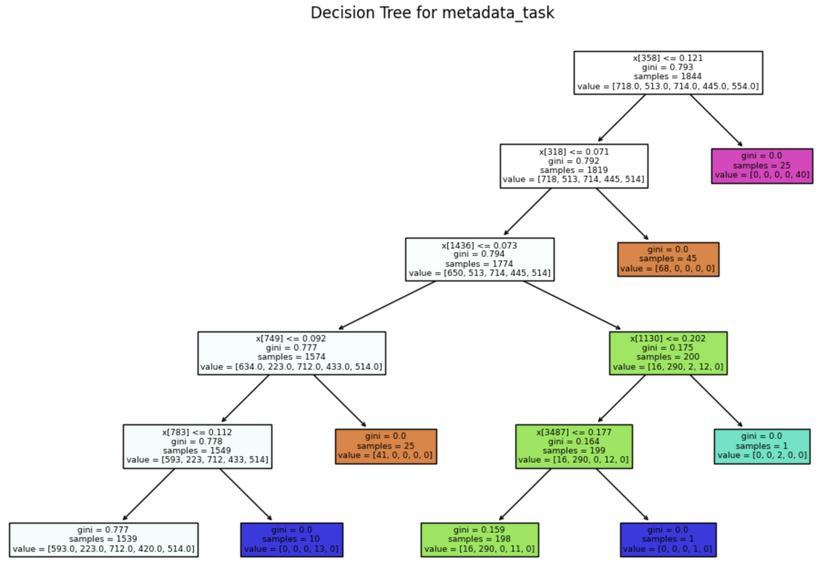
Model Building : Random Forest

Slide 14
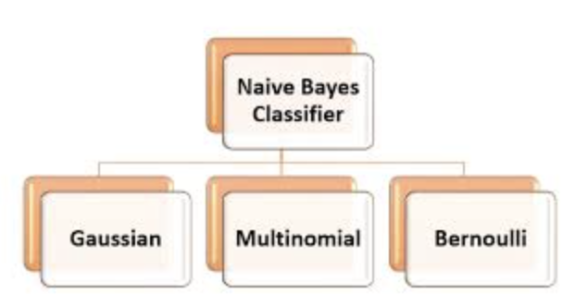
Model Building : Naive Bayes

Slide 15
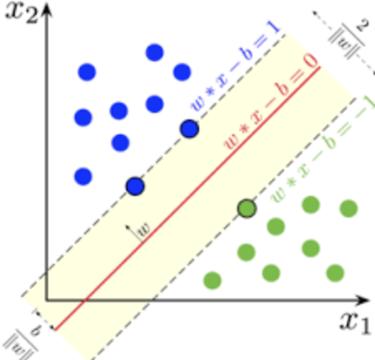
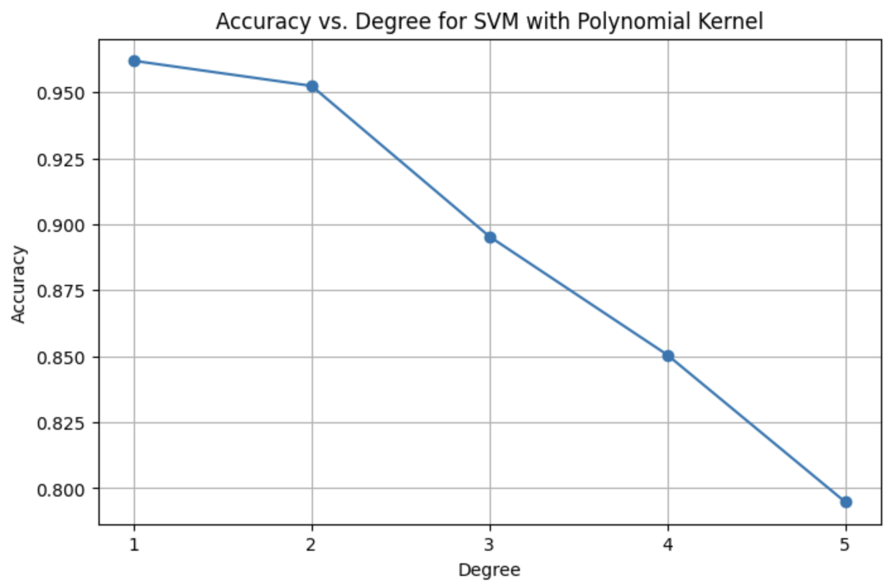
Model Building : SVM
After Grid search for svm, we obtain the best parameters.
Best parameters are { C = 10, kernel = Linear, Degree = 1}

Slide 16
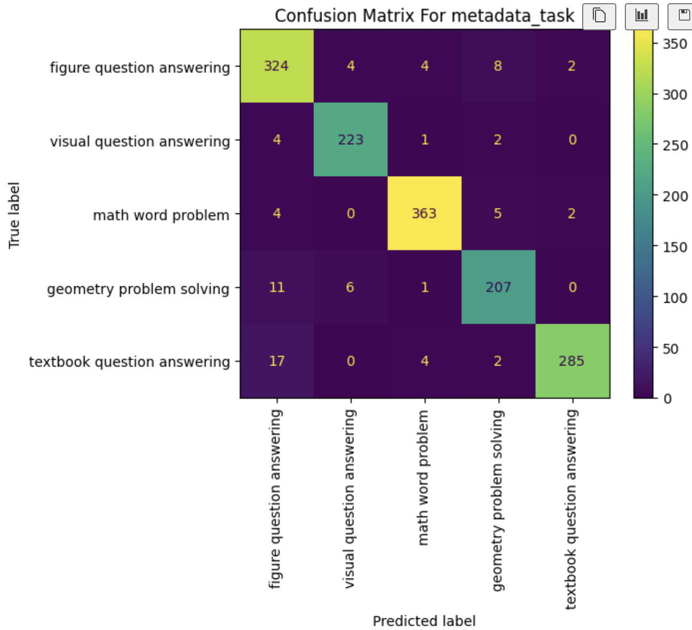
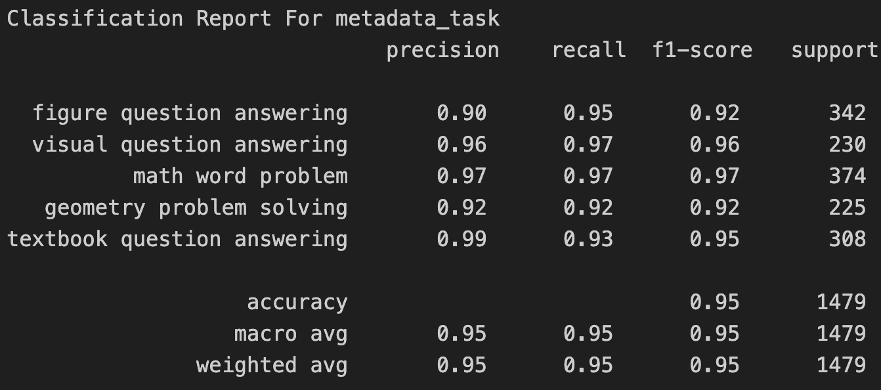
Evaluation : When Only Question Prompt is given
Accuracy of Metadata category | 96.3%
Accuracy of Metadata task | 94.93%
Accuracy of Metadata context | 88.79%
Accuracy of Metadata Grade | 90.43%
Accuracy of Metadata Language | 98.10%
We are going to use 3 different metrics for evaluating.
Accuracy
Confusion Matrix
F1 score and more

Slide 17
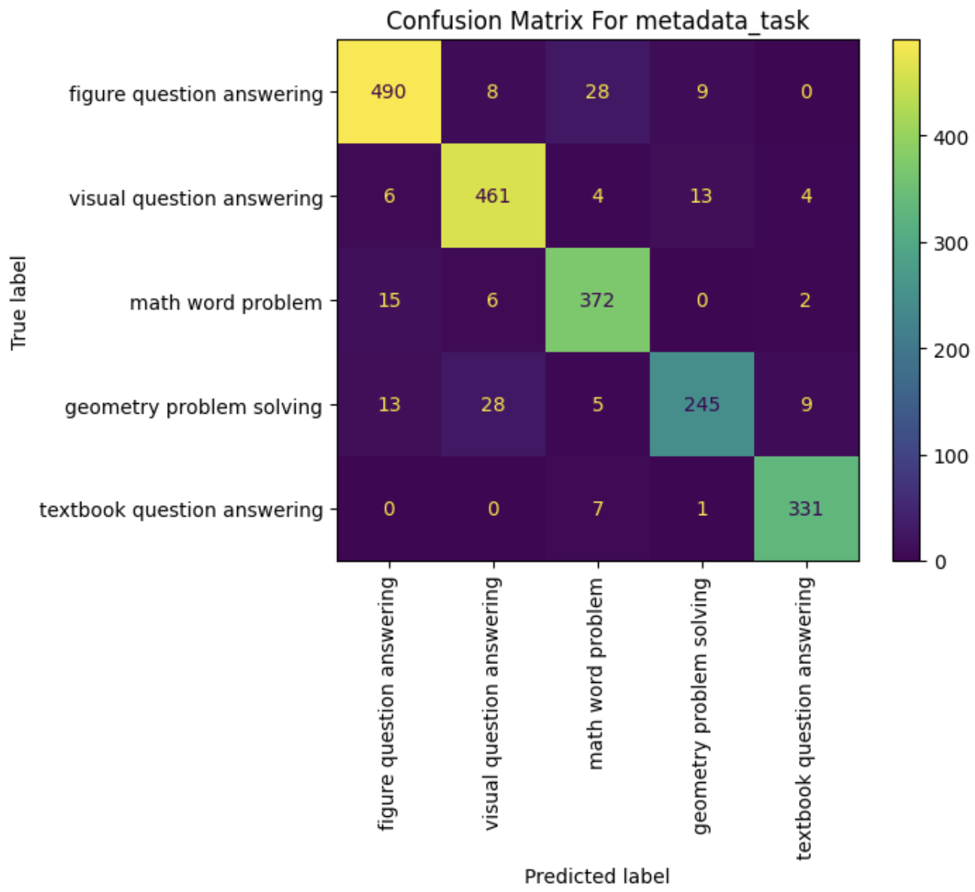
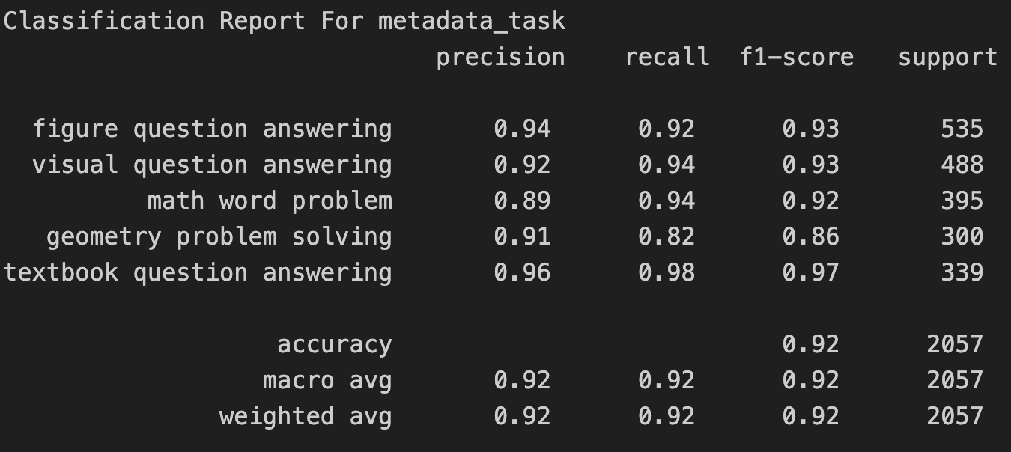
Evaluation : When Only Image Prompt is given
Accuracy of Metadata category | 96.69%
Accuracy of Metadata task | 92.32%
Accuracy of Metadata context | 90.47%
Accuracy of Metadata Grade | 89.20%
Accuracy of Metadata Language | 98.10%
We are going to use 3 different metrics for evaluating.
Accuracy
Confusion Matrix
F1 score and more

Slide 18

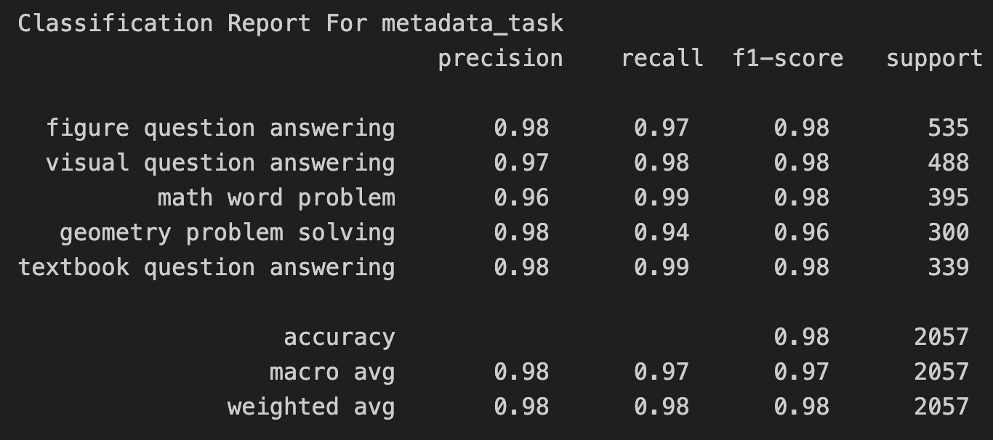
Evaluation : When Question And Image Prompt is given
Accuracy of Metadata category | 98.60%
Accuracy of Metadata task | 97.52%
Accuracy of Metadata context | 95.23%
Accuracy of Metadata Grade | 95.57%
Accuracy of Metadata Language | 98.68%
We are going to use 3 different metrics for evaluating.
Accuracy
Confusion Matrix
F1 score and more

Slide 19
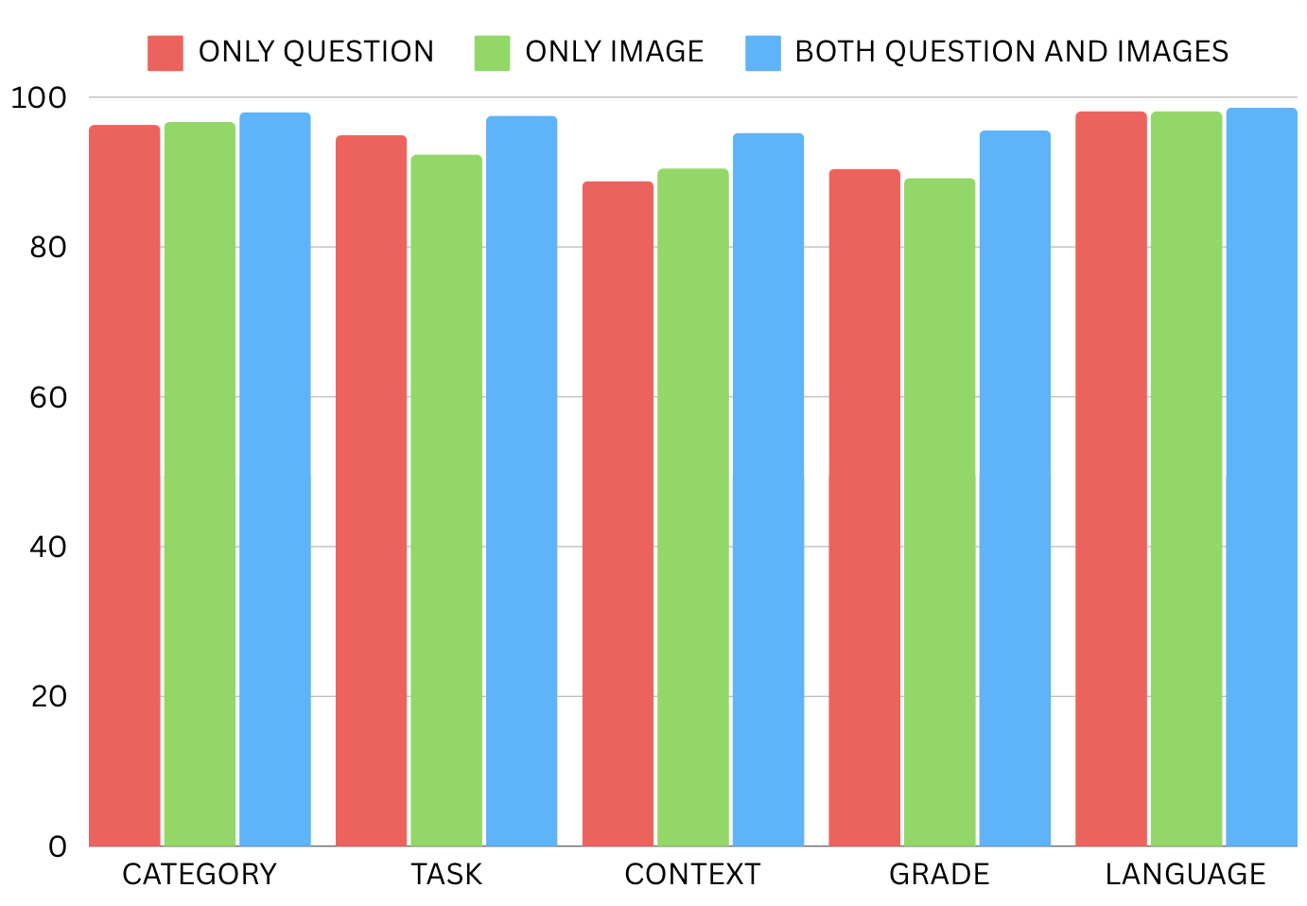
Comparison

Slide 20
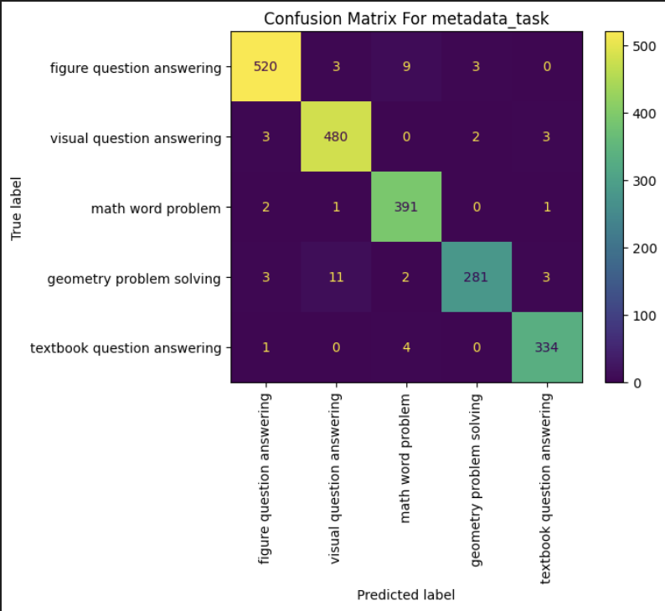
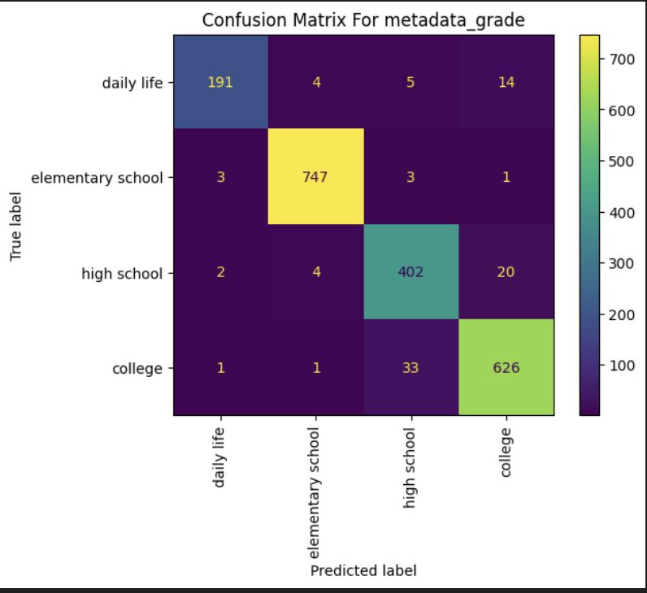
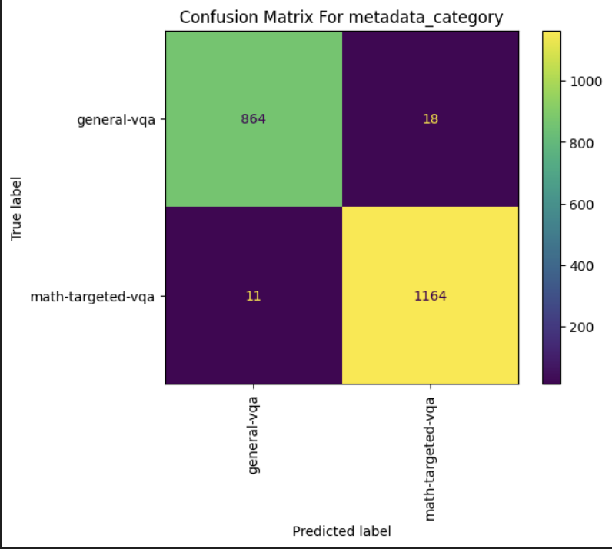
Different Classes Performance

Slide 21
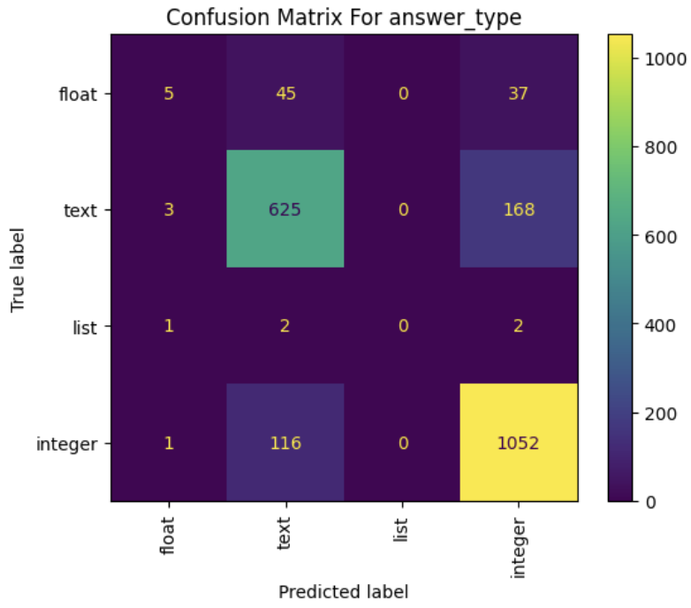
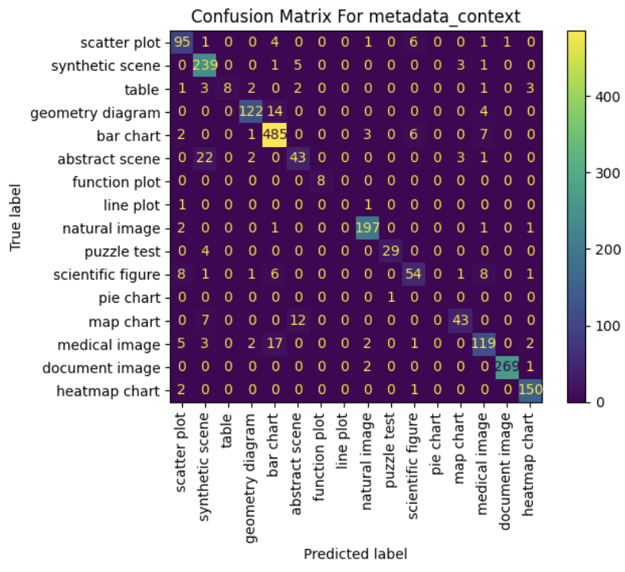
Classes With Bias
These 2 categories have heavy bias towards a few classes

Slide 22
Conclusion
Classification Happens Most Accurately when both Image and Text are given.
TF-IDF Embedding works best for our model.
METADATA Category gets best classified by our model after metadata language.
METADATA Context is usually the least accurately classified class.

Slide 23
PLEASE ENJOY THE LIVE DEMO

